Slide 1

Pointers and Dynamic Memory
Darrell Long
CSE 13S

Slide 2
What is a pointer?
A variable that holds a memory address.
The variable points to the location of an object in memory.
Not all pointers contain an address.
Pointers that don’t contain an address are set to the NULL pointer.
Value of the NULL pointer is 0.
NULL is a macro for either:
((void *)0)
0
0L
The definition depends completely on the compiler.

Slide 3
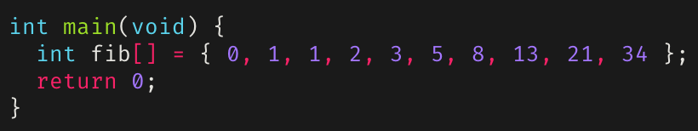
Review: Memory Addresses
Memory is stored in registers that can be accessed by a specific number (address).
Usually, each byte has a unique address.
Bytes are grouped into words (timeshare uses word size 4).
Address | 00 | 04 | 08 | 0C
A000_7FA0 | 00000000 | 00000000 | 00000000 | 00000000
A000_7FB0 | 00000000 | 00000001 | 00000001 | 00000002
A000_7FC0 | 00000003 | 00000005 | 00000008 | 0000000D
A000_7FD0 | 00000015 | 00000022 | 00000000 | 9D000350
A000_7FE0 | 00000000 | 00000000 | 00000000 | 00000000

Slide 4
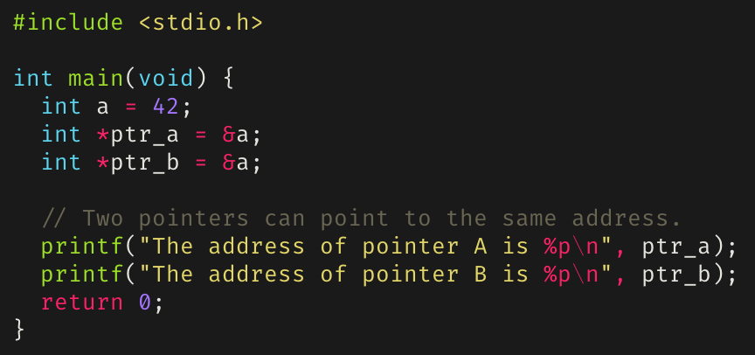
Pointers and addresses
Pointers are said to point at the address they are assigned.
Can assign a pointer the address of a variable using the address-of operator (&).
Multiple pointers can point to the same address.
Address | 00 | 04 | 08 | 0C
A000_7FA0 | 00000000 | 00000000 | 00000000 | 00000000
A000_7FB0 | 00000000 | 00000000 | 00000000 | 00000000
A000_7FC0 | 00000000 | 00000000 | A0007FD0 | A0007FD0
A000_7FD0 | 0000002A | 00000000 | 00000000 | 00000000
A000_7FE0 | 00000000 | 00000000 | 00000000 | 00000000

Slide 5
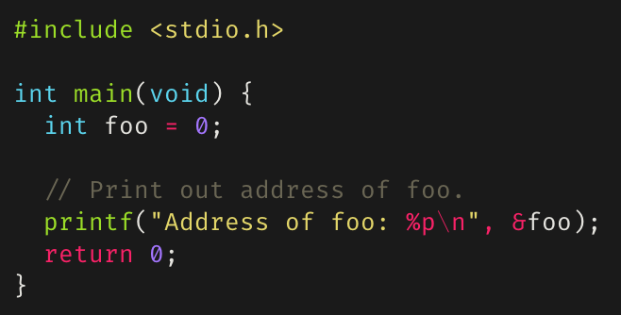
How to use the & operator
Example of using the & operator to access the address of a variable:

Slide 6
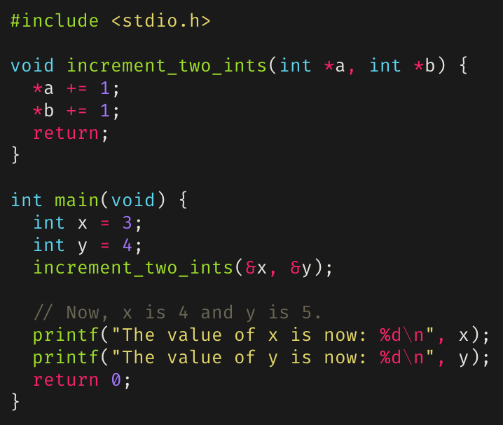
Dereferencing a Pointer
The object a pointer points to can be accessed through dereference, or indirection.
A pointer can be dereferenced using the dereferencing operator (*).
Useful for manipulating the values of several variables through call-by-reference.

Slide 7
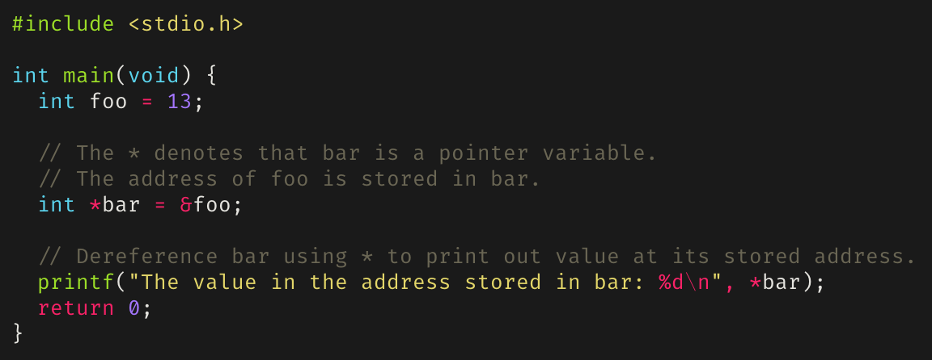
How to use the * operator
Example of using * to instantiate a pointer variable and using it to dereference a pointer:

Slide 8
Benefits of Pointers
Can be used when passing actual values is difficult.
Can “return” more than one value from a function.
Building dynamic data structures.
Useful for passing large data structures around.
Pointers are efficient for this since copies of data structures don’t need to be pushed into the stack.

Slide 9
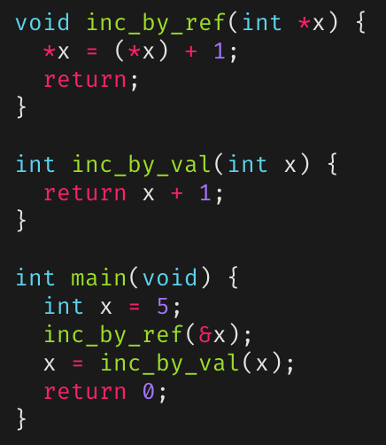
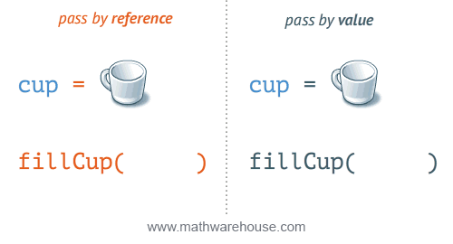
Passing by value versus Passing by reference
“Passing by value” duplicates passed values onto stack.
“Passing by reference” duplicates a pointer onto the stack.

Slide 10
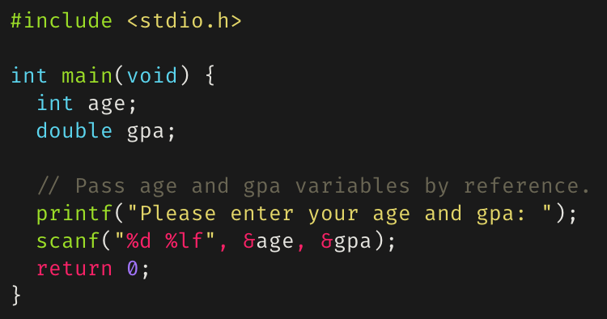
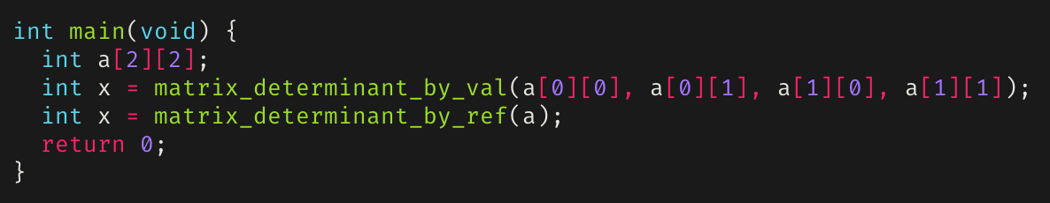
Passing by reference
Allows “returning” multiple values.
Allows passing large amounts of data quickly.
You’re not copying the data, just telling where it is stored.

Slide 11
Pointer Arithmetic
Since pointers in C are just an addresses, numeric values, you can perform arithmetic on them.
++ : increments to next address (increment by 4 bytes assuming 32-bit integers.
-- : decrements to previous address.
+ : can only add a numeric value to a pointer (no pointer and pointer addition).
- : if a pointer is subtracted from another pointer, the distance between both addresses is calculated.
Pointers can also be compared using relational operators (e.g. ==, <=, <, etc.).

Slide 12
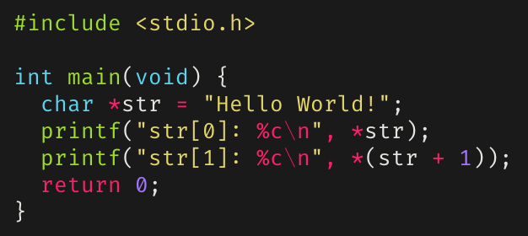
Pointer Arithmetic
Can offset a pointer by adding/subtracting an integer.
Can get the number of elements between two pointers by getting their difference.
Cannot sum, divide, or multiply two pointers.

Slide 13
Arrays And Pointer Arithmetic
1000
1001
For int arr[i]:
arr[i] == *(a + i)
If arr starts at address 1000, then arr[i] is at 1000 + (i * 4)
Why? An int is typically 4 bytes
If arr was an array of uint64_t’s, then arr[i] would be at 1000 + (i * 8)
You can use sizeof() to get the size in bytes of scalar types
arr[0]
1002
1003
1004
1005
arr[1]
1006
1007
1008
1009
arr[2]
1010
1011

Slide 14

But does it make sense?
Adding an int to a pointer makes sense.
Subtracting an int from a pointer makes sense.
Subtracting two pointers makes sense.
Adding two pointers makes no sense.
Multiplying or dividing with pointers never makes sense.

Slide 15
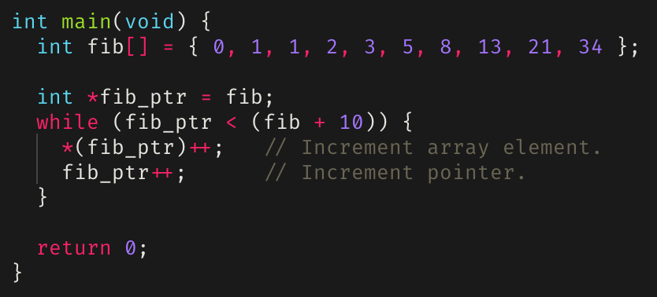
Pointer arithmetic example: Iterating over an array
fib_ptr
Address | 00 | 04 | 08 | 0C
A000_7FA0 | 00000000 | 00000000 | 00000000 | 00000000
A000_7FB0 | 00000000 | 00000000 | A0007FBC | 00000001
A000_7FC0 | 00000002 | 00000002 | 00000003 | 00000004
A000_7FD0 | 00000005 | 00000008 | 0000000D | 00000000
A000_7FE0 | 00000022 | 00000000 | 00000000 | 9D000390

Slide 16
Pointers and arrays
Array subscripting can also be done with pointers.
Using pointer arithmetic in general is faster, but harder to understand.
Assuming some array int arr[10]:
arr[i] is equivalent to *(arr + i), where 0 <= i < 10
Arrays can always be written using pointers.
Declaring an array in a function allocates it on the stack.
A global array is in the data area.
Dynamically declaring an array (to get a pointer) allocates it on the heap.

Slide 17
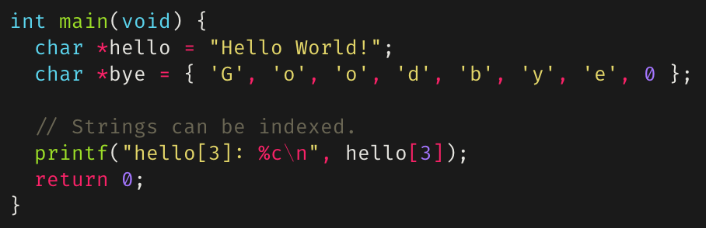
Strings as arrays
In C, strings are handled as arrays
With some special syntax, for convenience
A string is a pointer to an array of chars
Strings can be indexed, passed by reference, etc.
Address | 00 | 04 | 08 | 0C | ASCII
0000_7FB0 | 00000000 | 00000000 | 00000000 | 00000000 | ........ ........
0000_7FC0 | 6C6C6548 | 6F57206F | 21646C72 | 00000000 | Hello Wo rld!....
0000_7FD0 | 646F6F47 | 00657962 | 00000000 | 9D0007B8 | Goodbye. ........
0000_7FE0 | 00000000 | 00000000 | 00000000 | 00000000 | ........ ........

Slide 18
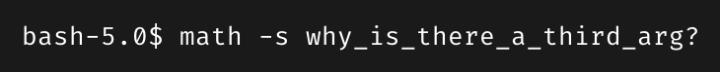
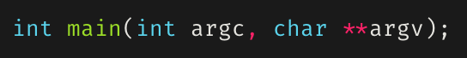
Pointers to pointers
**argv
argv
*argv
Pointers can point to other pointers
or to pointers to other pointers, or to pointers to pointers to pointers, etc
Can be used to pass arrays of arrays, such as a list of strings
For example, char **argv
Address | 00 | 04 | 08 | 0C | ASCII
A000_7F80 | 00000000 | 00000000 | 00000000 | 00000000 | ........ ........
A000_7F90 | 00000000 | 00000000 | 00000003 | A0007FD4 | ........ ......□.
A000_7FA0 | 6874616D | 00000000 | 0000732D | 5F796877 | math.... -s..why_
A000_7FB0 | 745F7369 | 65726568 | 745F615F | 64726968 | is_there _a_third
A000_7FC0 | 6772615F | 0000003F | A0007FA0 | A0007FA8 | _arg?... .□...□..
A000_7FD0 | A0007FAC | A0007FC8 | 00000000 | 00000000 | .□...□.. ........
A000_7FE0 | 00000000 | 00000000 | 00000000 | 00000000 | ........ ........

Slide 19
Pointers to pointers
argv
**(argv + 1)
*argv
Pointers can point to other pointers
or to pointers to other pointers, or to pointers to pointers to pointers, etc
Can be used to pass arrays of arrays, such as a list of strings
For example, char **argv
Address | 00 | 04 | 08 | 0C | ASCII
A000_7F80 | 00000000 | 00000000 | 00000000 | 00000000 | ........ ........
A000_7F90 | 00000000 | 00000000 | 00000003 | A0007FD4 | ........ ......□.
A000_7FA0 | 6874616D | 00000000 | 0000732D | 5F796877 | math.... -s..why_
A000_7FB0 | 745F7369 | 65726568 | 745F615F | 64726968 | is_there _a_third
A000_7FC0 | 6772615F | 0000003F | A0007FA0 | A0007FA8 | _arg?... .□...□..
A000_7FD0 | A0007FAC | A0007FC8 | 00000000 | 00000000 | .□...□.. ........
A000_7FE0 | 00000000 | 00000000 | 00000000 | 00000000 | ........ ........
19

Slide 20
Multidimensional Arrays
int a[3][3] = {{0, 1, 2},
{3, 4, 5},
{6, 7, 8}};
Row, Column
a[y][x]
Column
In some cases, arrays of arrays support a more compact data structure:
If data is of same type, and each sub-array is of same length, a multidimensional array is appropriate.
a[0][0] = 0;
a[0][1] = 1;
a[0][2] = 2;
a[1][0] = 3;
a[1][1] = 4;
a[1][2] = 5;
a[2][0] = 6;
a[2][1] = 7;
a[2][2] = 8;
0
1
2
x
Row 0
0
0
1
2
0,0
0,1
0,2
Row 1
3
4
5
1
Row
1,0
1,1
1,2
Row 2
2
6
7
8
2,0
2,1
2,2
y

Slide 21
Multidimensional Arrays
int[2][2][2] = {{{0, 1},{2, 3}},
{{4, 5},{6, 7}}};
Plane, Row, Column
a[z][y][x]
1
z
Multidimensional arrays can be of any dimensionality.
Note: these grow in size very rapidly!
Plane
a[0][0][0] = 0;
a[0][0][1] = 1;
a[0][1][0] = 2;
a[0][1][1] = 3;
a[1][0][0] = 4;
a[1][0][1] = 5;
a[1][1][0] = 6;
a[1][1][1] = 7;
0
4
Row 0
0
Column
5
0
Row
1,0,1
0,0,0
1
x
7
1
2
0,0,1
1,1,1
y
0,1,0
3
0
0,1,1
1

Slide 22
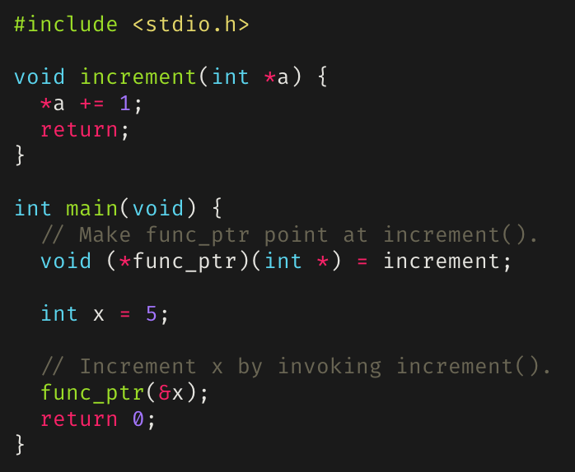
Function Pointers
Points to executable code in memory instead of a data value.
Dereferencing a function pointer yields the referenced function.
Notice how there are parentheses around the function pointer.
Without them, the function pointer would be parsed as a function declaration.

Slide 23
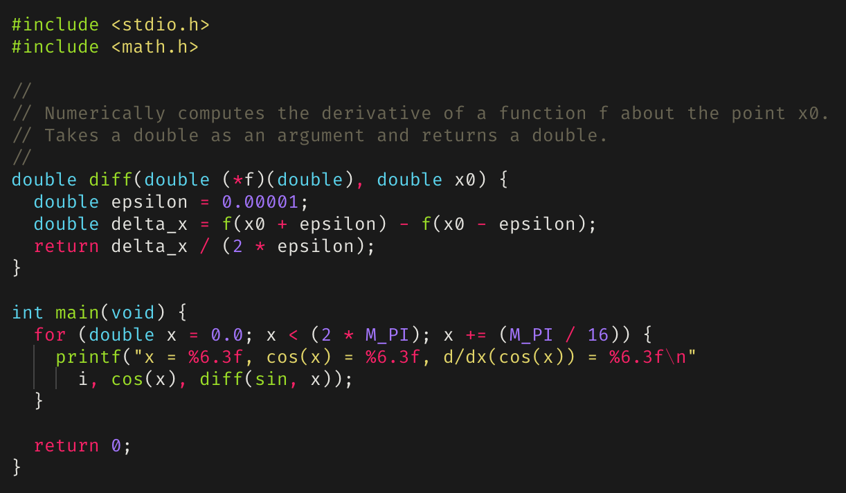
Function Pointer Example

Slide 24
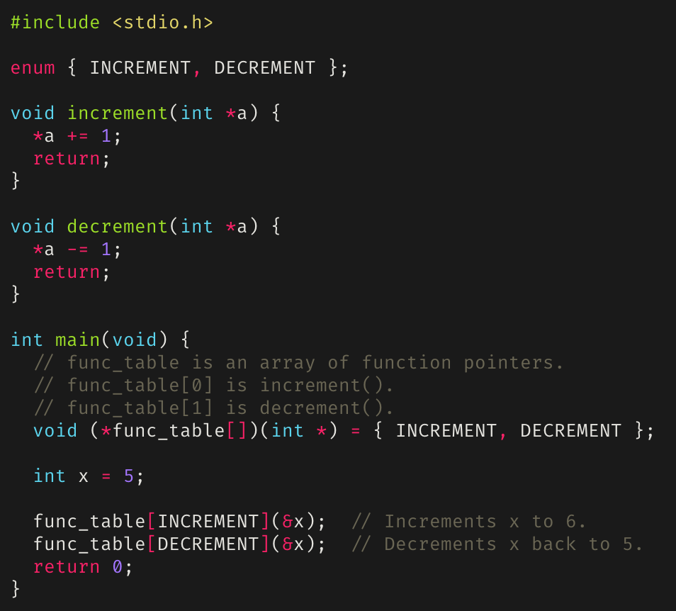
Function Tables (Jump Tables)

Slide 25

Dynamic Memory Allocation
Dynamic memory is memory that is allocated at run-time.
It is allocated from a region of memory that we call the heap.

Slide 26

What is dynamic memory allocation?
The act of allocating memory for variables on the heap (or called free store) during program run-time.
Quite different than compile time (static) allocation:
Compile time allocation (CTA) means memory for named variables is allocated by the compiler at compile time,
Dynamic memory allocation (DMA) means memory is allocated on-the-fly during run-time.
CTA requires the exact size and type of storage at compile time, DMA is calculated and allocates the exact memory it needs during run-time.

Slide 27

Why is dynamic memory allocation good?
Stack space is limited.
We sometimes want variables to last beyond the lifetime of its current scope:
Variables on the stack don’t last beyond its current scope.
Variables dynamically allocated on the heap can be accessed beyond the current scope.
We don’t always know exactly how much memory is needed to run a program.
Solution: dynamically allocate memory when it’s needed, however much is needed.
But how do we dynamically allocate memory?

Slide 28
Dynamic memory allocation
There are three standard C library functions to allocate memory, all of which are defined under stdlib.h
malloc(), calloc(), and realloc()
These three functions dynamically allocate memory on the heap and returns a pointer to the allocated memory
Allocated memory must be freed using free().
Not freeing allocated memory can lead to depletion of system resources.
This is called a memory leak.

Slide 29
The Heap
A large region of unmanaged, anonymous memory.
Only limitations are your computer’s physical limitations.
Slower to read from/write to due to the need for pointers.
Variables using heap memory can be accessed globally.
A benefit of using pointers; much easier to pass around pointers for large data structures.
Possible memory fragmentation can occur over time as blocks of memory are allocated and deallocated.

Slide 30
malloc()
Defined as:
void* malloc(size_t size)
Returns a pointer to [size] bytes of uninitialized memory allocated on the heap.
The memory allocated by malloc() may contain junk data.
What happens when zero is passed as the specified number of bytes to allocate is implementation defined (avoid doing this).
Doesn’t check for overflow of [size] if it’s the result of an arithmetic operation, unlike calloc().

Slide 31
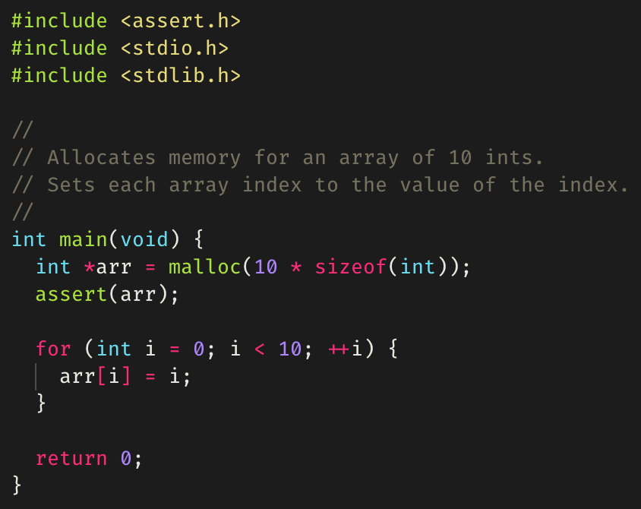
Example of malloc()

Slide 32
calloc()
Defined as:
void* calloc(size_t nmemb, size_t size)
[nmemb] denotes the number of objects and [size] the size of each object.
Returns a pointer to [nmemb] * [size] bytes of allocated memory on the heap, in which each byte has been initialized to zero.
Like malloc(), behavior when [nmemb] is zero is implementation defined.
Generally slower than malloc(), but the tradeoff is that the contents of the allocated memory are known since it’s zeroed out.

Slide 33
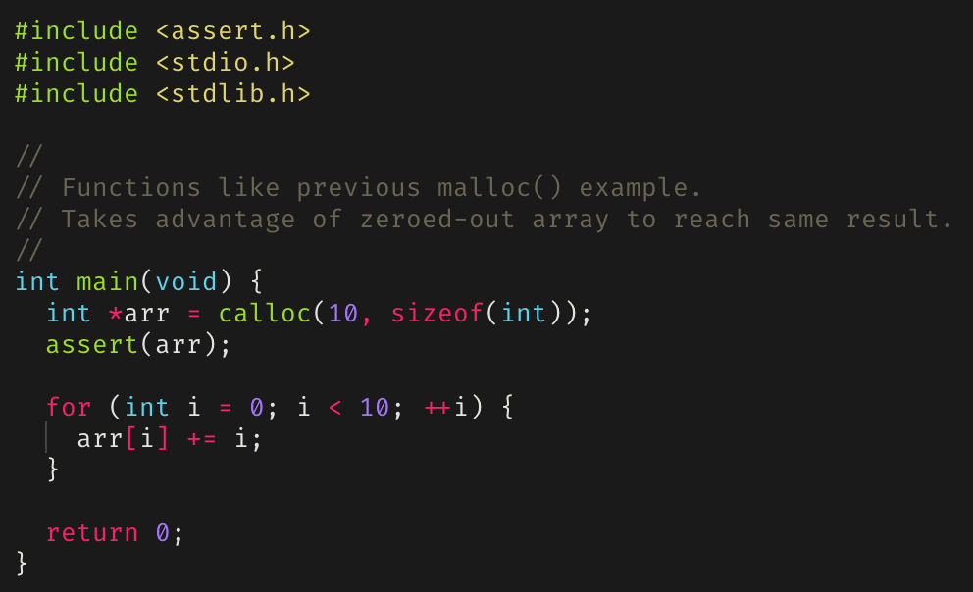
Example of calloc()

Slide 34
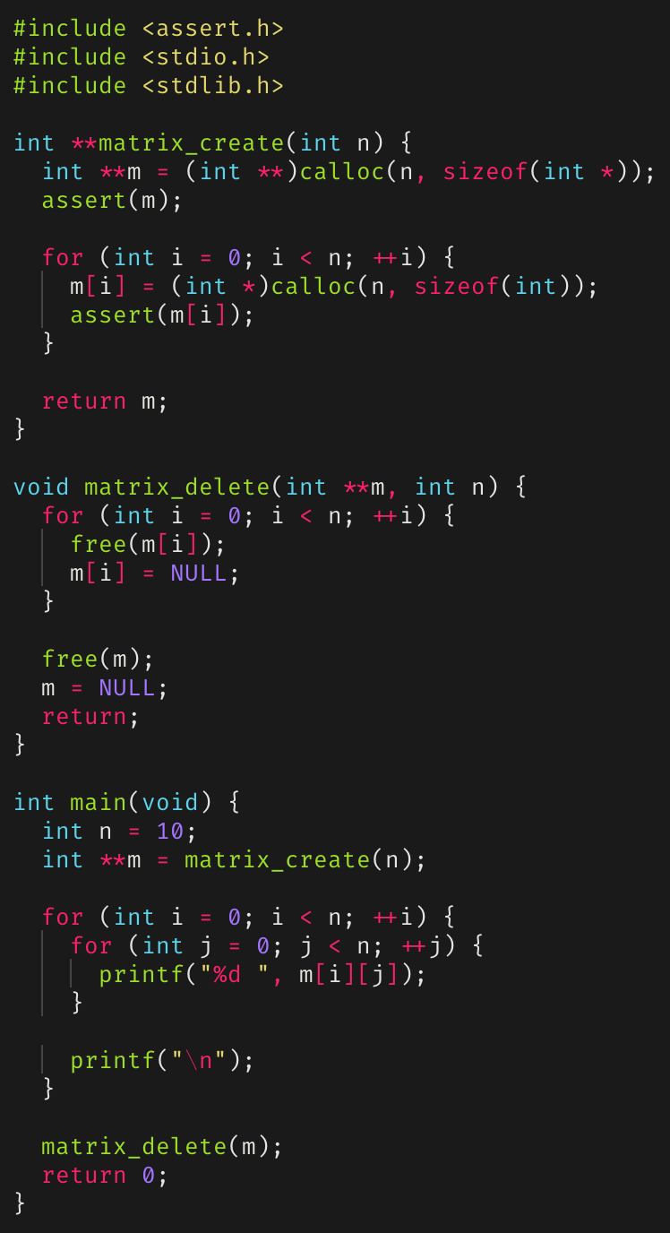
Dynamic Memory Allocation example: A dynamic n × n matrix
Example of dynamically allocating an n × n matrix.
The destructor, matrix_delete(), iterates and frees the allocated memory for each pointer.

Slide 35
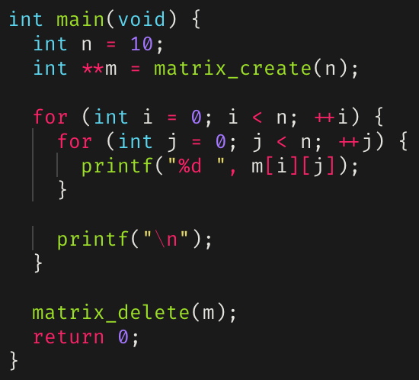
Dynamic matrix: main()

Slide 36
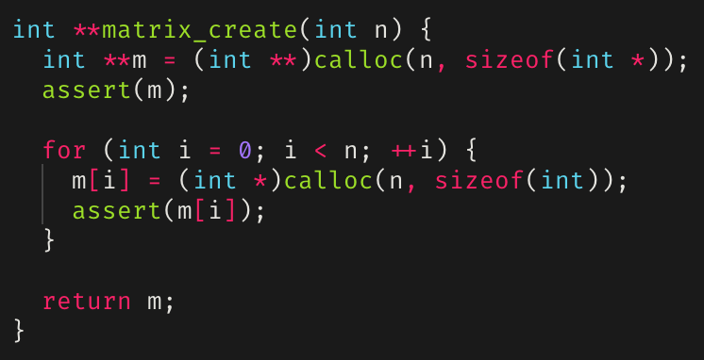
Dynamic matrix matrix_create()

Slide 37
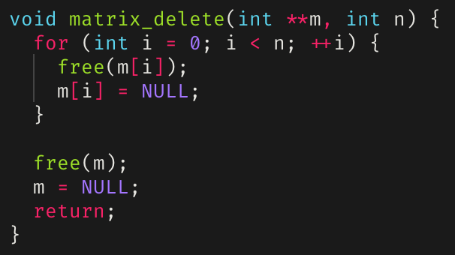
Dynamic matrix
matrix_delete()

Slide 38
realloc()
Defined as:
void *realloc(void *ptr, size_t size)
Reallocates [ptr] to newly point at [size] bytes of allocated memory on the heap.
This is not strictly true; what realloc() actually does is deallocate the old object pointed to by [ptr] and return a pointer to [size] bytes of allocated but uninitialized memory.
If [size] is greater than the size of the originally allocated block of memory, the contents of the returned pointer contains everything from the original block, but the extra allocated memory is uninitialized
Else if [size] is less than the size of the originally allocated block of memory, the contents of the returned pointer contains exactly the beginning [size] bytes from the original block

Slide 39
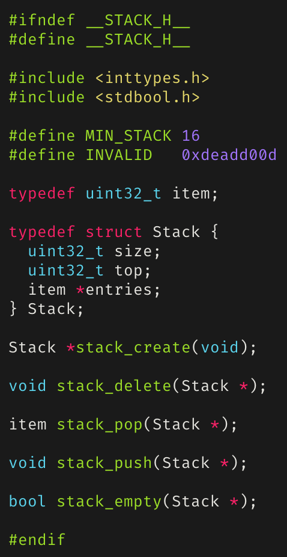
A Dynamically Growing Stack

Slide 40
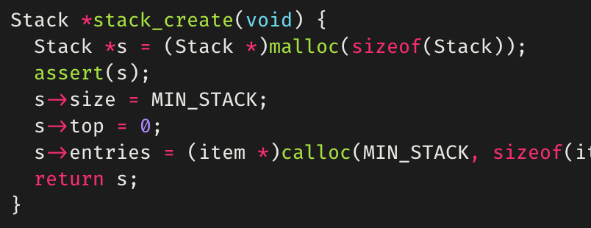
Dynamic Stack: stack_create()

Slide 41
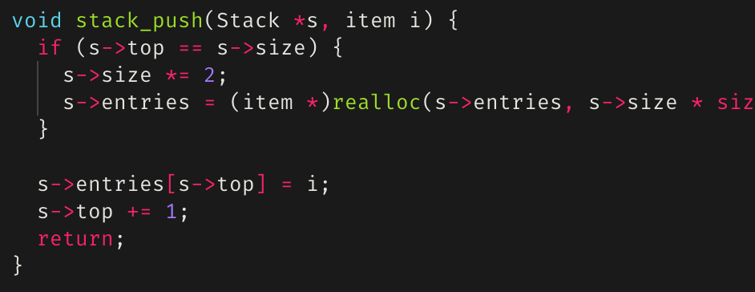
Dynamic Stack: stack_push()

Slide 42
free()
If we allocate memory, we must also be able to deallocate (or free) memory.
Another standard C library functions specifically for deallocating memory allocated by malloc(), calloc(), or realloc().
Defined as void free(void *ptr)
Deallocates the memory space pointed to by [ptr].
Memory leaks occur if allocated memory isn’t freed.
Segmentation faults/core dumps can occur if a program tries to access memory locations that it isn’t allowed to access.
Pointers that have been freed should be set to NULL to mitigate use-after-free vulnerabilities.

Slide 43
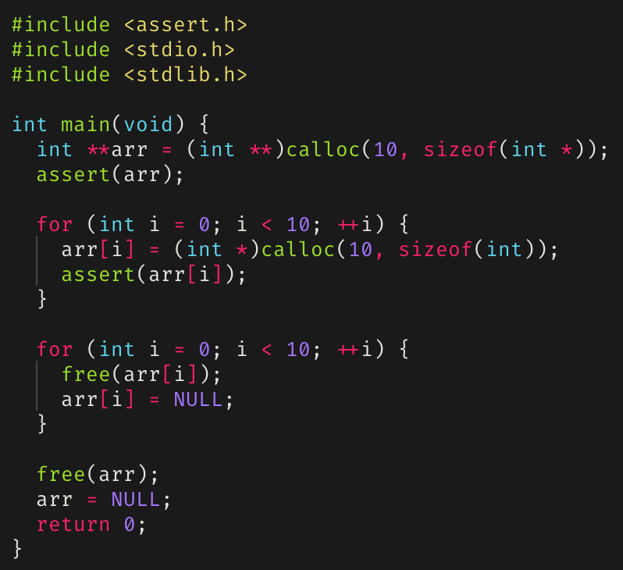
Example of free()

Slide 44
Detecting Memory Leaks and Segmentation Faults
Memory leaks and segmentation faults, as well as other errors, can be detected using gdb, infer, or valgrind
These tools can be found on the UCSC Unix timeshare.
Should be used in tandem when debugging.

Slide 45
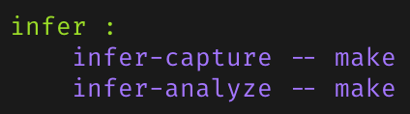
infer
A static analysis tool to detect bugs in C, C++, and Java.
Checks for null pointer exceptions, resource leakage, race conditions, and missing lock guards.
On the left is an example of a make infer target in a Makefile.

Slide 46

valgrind
A collection of dynamic analysis tools.
Usually used for its memcheck tool, which can detect:
Use of uninitialized memory.
Reading/writing memory after it has been freed.
Reading/writing off the end of allocated blocks of memory.
Reading/writing inappropriate areas on the stack.
Memory leaks – where pointers to malloc’d blocks are lost forever.
Useful command line flags/options for valgrind
--leak-check=full
--show-leak-kinds=all

Slide 47
Static versus dynamic analyzers
Static analyzers, like infer, operate by analyzing the source code for a program before it’s run.
Code is compared against a set (or multiple sets) of coding rules for bugs.
Only surface level; can’t check if a function behaves completely as it’s supposed to when it’s executed.
Dynamic analyzers, like valgrind, operate by tracking down errors that occur during program execution.
Good for checking if the program executes as it’s supposed to,
Can only analyze what happens during execution,
Things that don’t occur during execution aren’t analyzed.
Let’s see examples of differences in analysis output for infer and valgrind.

Slide 48
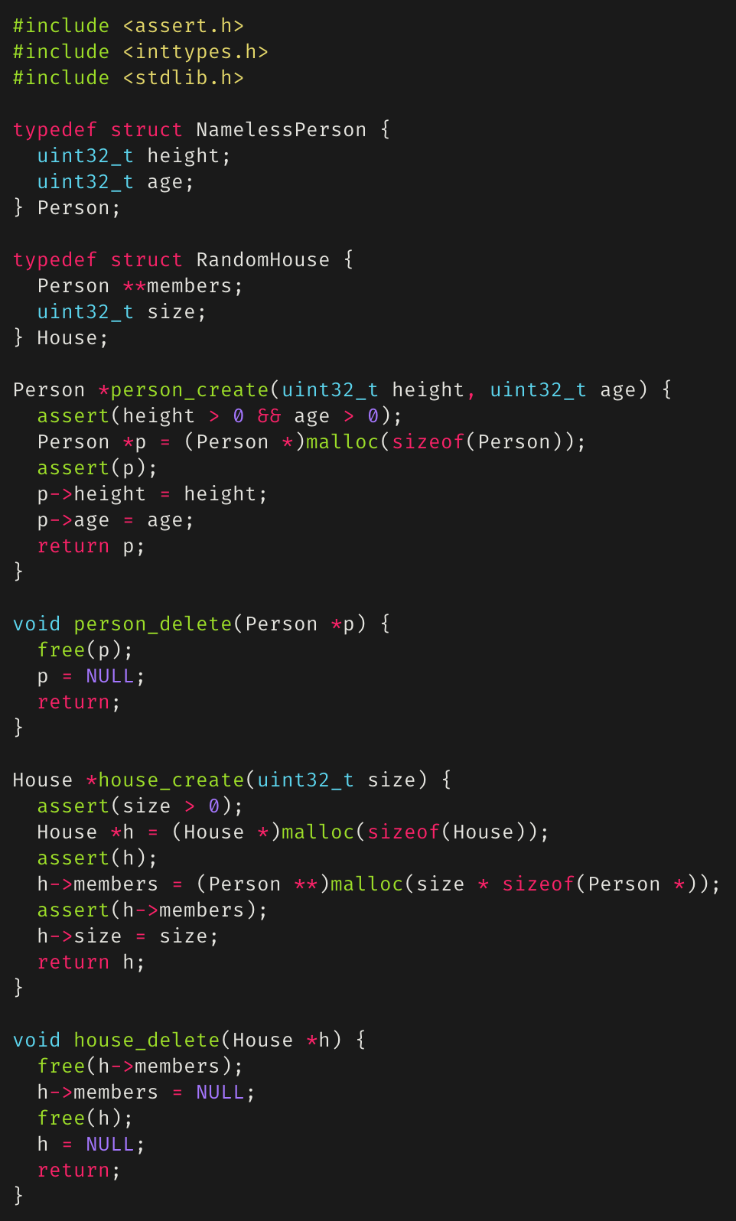
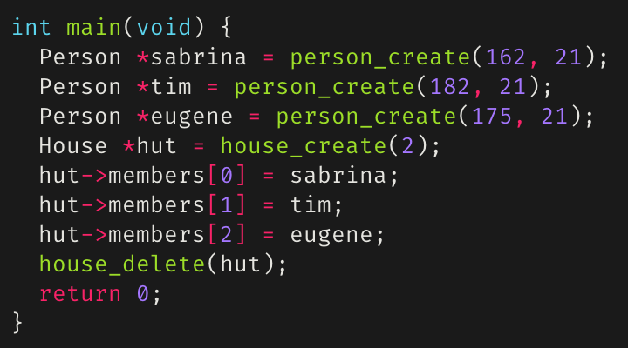
Debugging with infer
Consider the person/house code module on the right.
Now consider the main function below:
Is there anything wrong?
Let’s statically analyze this with infer.

Slide 49
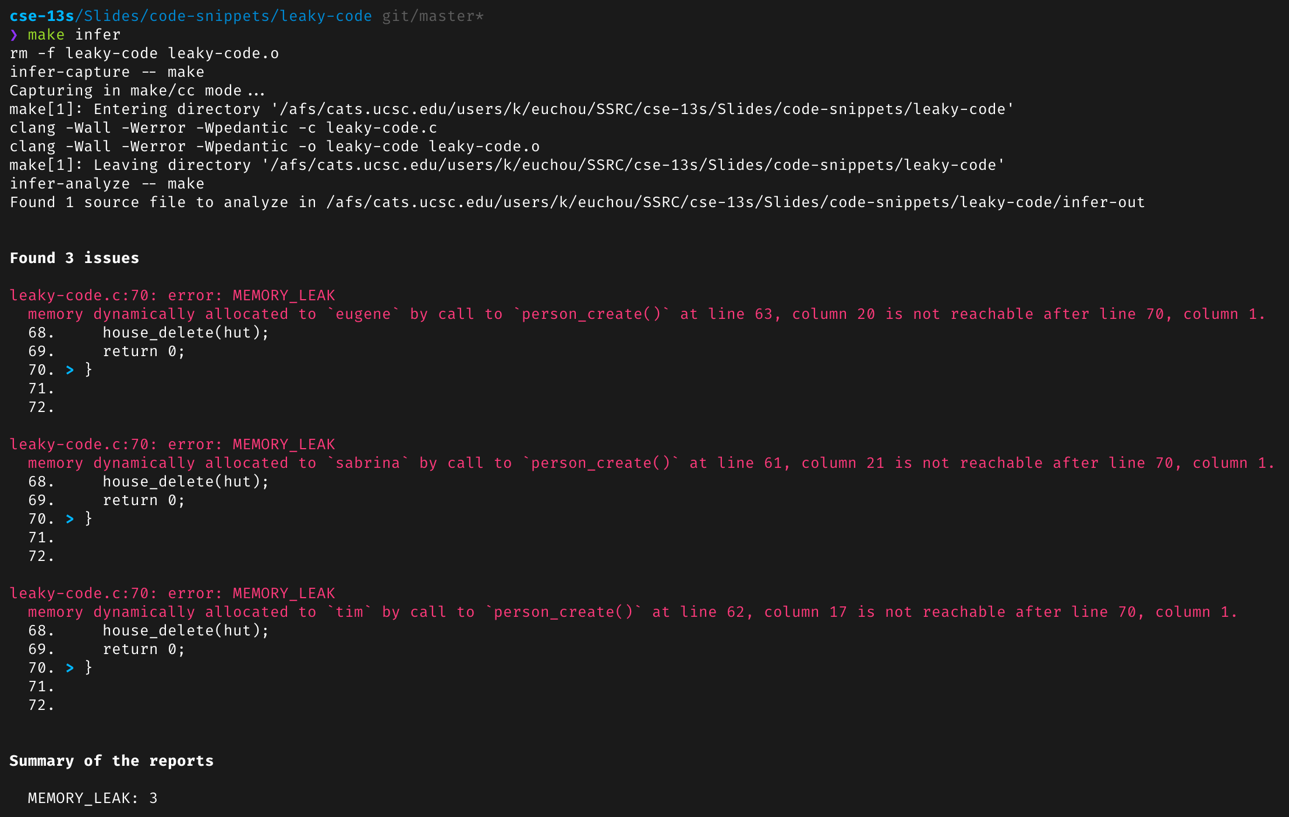
Debugging with infer (cont’d)
Running infer using:
infer-capture -- make
infer-analyze -- make

Slide 50
Debugging with infer (cont’d)
We can see that we have three memory leaks, all of which are from the fact that we allocated memory for three person *’s but never freed them.
We can fix this by adding a loop to house_delete() to call person_delete() for each person in the members field of a house and to free the third person in the main function.
However, the main function only allocated space for two people in the house, but infer didn’t report anything when the main function added a third person to the house.
This is where we further debug with valgrind.

Slide 51
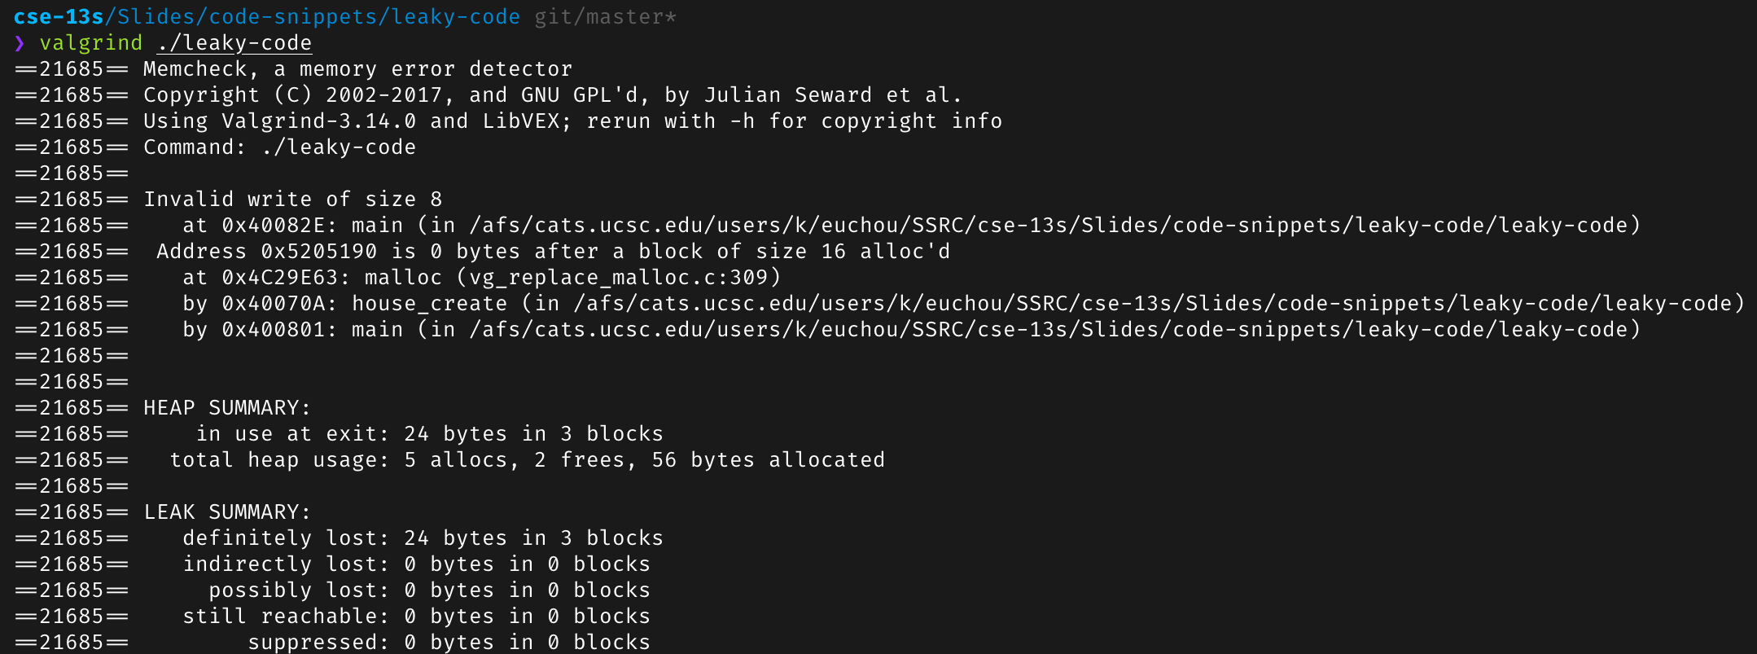
Debugging with valgrind
valgrind output for the same program checked earlier with infer:

Slide 52
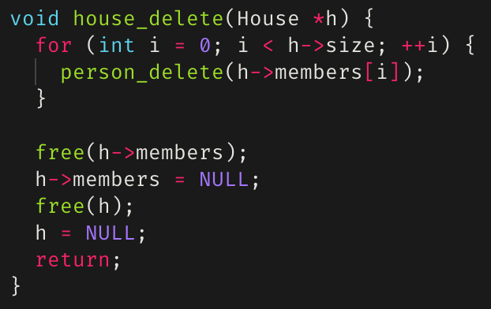
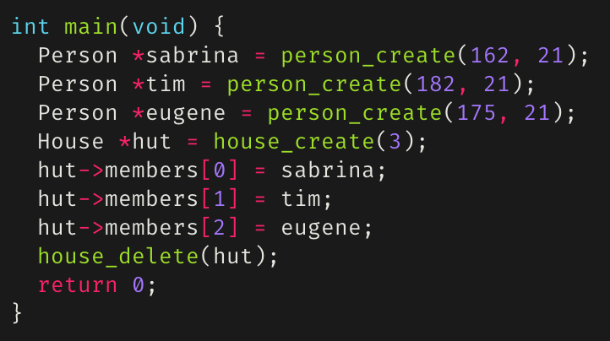
Debugging with valgrind (cont’d)
As we can see, we still see the memory leaks caused by the three persons, and now we also see that trying to add a person to the house caused an invalid write
We can fix house_delete() as seen on the right:
And we can either change the main function to either not add the third person to the house and call person_delete()on them, or instantiate the house to fit 3
Applying the above changes will result in a leak and error free program

Slide 53
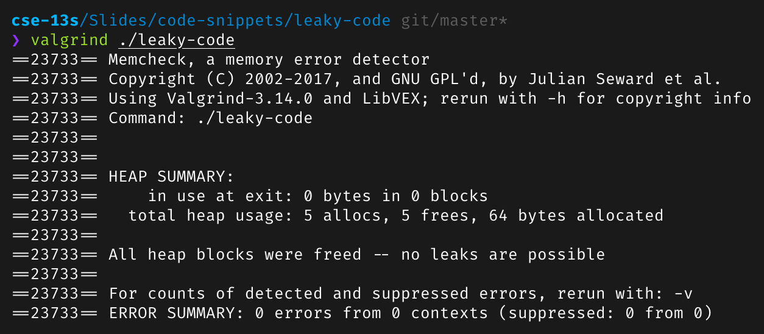
valgrind() on debugged program
Looking good!
But what about infer?

Slide 54
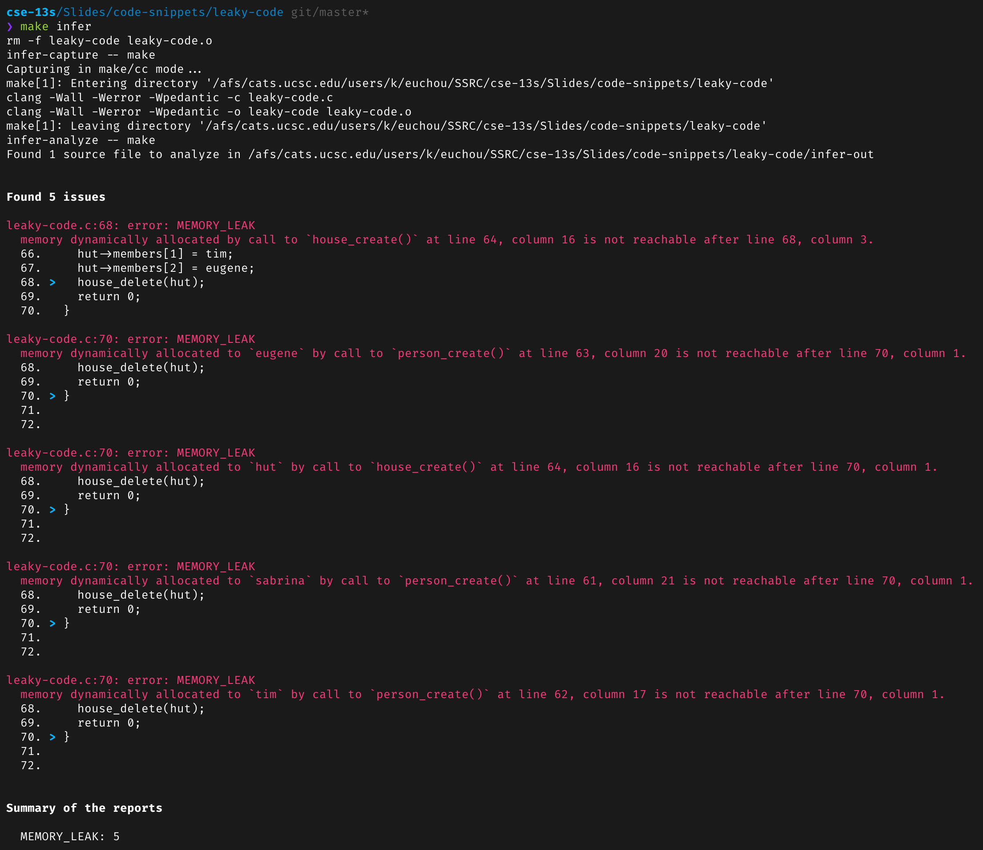
infer on a debugged program
There are still errors!
This is “okay”
infer is far from perfect
What are reported as memory leaks are freed later on in the code in other functions.
Any errors reported by infer that aren’t correct must be explained in your README.md.

